Slide 1
Login Management System Using Tkinter

Slide 2
Objective
Need
Scope
Technology
Expected output
Conclusion

Slide 3
Objective
The main objective of the Project on Login Management System is to manage
the details of Username, Password, Email, Changing Password, Permission and
Authorization. It manages all the information about Username, Groups, Permission and Authorization, Username. The project is totally built at administrative end and thus only the administrator is guaranteed the access.
The purpose of the project is to build an application program to reduce the manual work for managing the Username, Password, Groups, Email.
Provides the searching facilities based on various factors. Such as Username,
Email, Changing Password, Permission and Authorization
Password details, Permission and Authorization details, Username
It tracks all the information of Password, Groups, Changing Password

Slide 4
Need of this project
The old manual system was suffering from a series of drawbacks. Since whole of the system was to be maintained with hands the process of keeping, maintaining and retrieving the information was very tedious and lengthy. The records were never used to be in a systematic order. there used to be lots of difficulties in associating any particular transaction with a particular context.
If any information was to be found it was required to go through the different registers, documents there would never exist anything like report generation. There would always be unnecessary consumption of time while entering records and retrieving records.
The reason behind it is that there is lot of information to be maintained and have
to be kept in mind while running the business .For this reason we have provided
features Present system is partially automated (computerized), actually existing system is quite laborious as one has to enter same information at three different places.

Slide 5
Scope
It may help collecting perfect management in details. In a very short time, the
collection will be obvious, simple and sensible. It will help a person to know the
management of passed year perfectly and vividly. It also helps in current all works relative to Login Management System. It will be also reduced the cost of collecting the management & collection procedure will go on smoothly.
Our project aims at Business process automation, i.e. we have tried to
computerize various processes of Login Management System.

Slide 6
Technology and Tools
Python
Tkinter
Windows 10
Jupyter
VS Studio

Slide 7
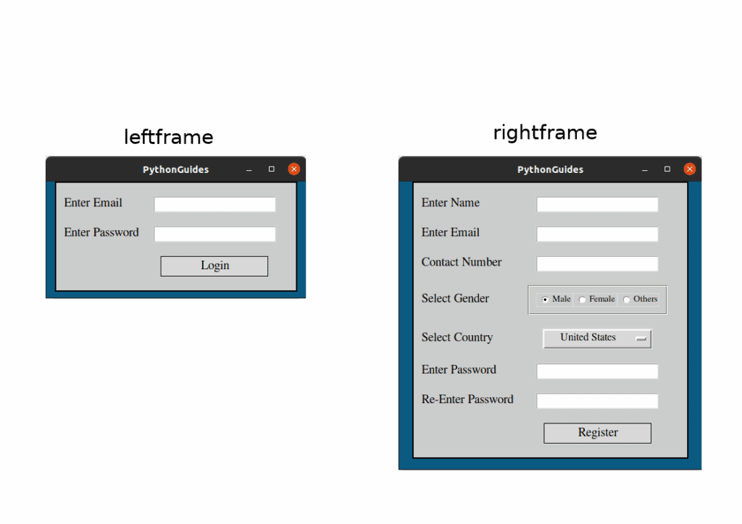
Expected Output

Slide 8
Reference
Google for problem solving
http://www.javaworld.com/javaworld/jw-01-1998/jw-01-Credentialreview.html
Database Programming with JDBC and Java by O'Reilly
Head First Java 2nd Edition
http://www.jdbc-tutorial.com/
Java and Software Design Concepts by Apress
https://www.tutorialspoint.com/java/

Slide 9
Conclusion
Our project is only a humble venture to satisfy the needs to manage their project
work. Several user friendly coding have also adopted. This package shall prove to be apowerful package in satisfying all the requirements of the school.
The objective of software planning is to provide a frame work that enables the manger to make reasonable estimates made within a limited time frame at the beginning of the software project and should be updated regularly as the project progresses.
At the end it is concluded that we have made effort on following points...
A description of the background and context of the project and its relation to work already done in the area

